Slide 1
CERAMIC VALVE
CHANGER Co Ltd
AUTO VISUAL INSPECTION
ECN
DATE : 11th SEPT 2018

Slide 2
CERAMIC VALVE – AUTO VISUAL INSPECTION
Visit details
Members : Mr Azham (CV HOD)
Mr Eruan (FMD)
Mr Siva (QA)
Supplier : Chernger Tech Co Ltd Mr Liu
Date : 11th Sept
Agenda discussion
UPH
Mixing & Single ➔ 1sec/pc
Total : 43.2K/day (24hrs operation) Required mc : 2unit for 80kpcs/day
2. Machine operation – Detail
Safety – Standard safety features included
Maintenance – 5years guranttee with 24hrs operation. Lighting life is 42000hrs (3 ~ 5 years)
Manual (Software & hardware) – will provide as per maruwa’s requirement
3. Sample result verification (Previous & new sample)
Initial sample – pass and able to detect
2nd sample – concentrate more to critical sample with severe defect (inlap). Supplier need to fine tune the camera for detetction. Supplier will feedback on mondat 17th Sept

Slide 3
CERAMIC VALVE – AUTO VISUAL INSPECTION
4. Result storage
Image storage
Running qty - linkage to PC system (server)
Machine program coding
Data storage mode – SQL format
Supplier able to comply with Maruwa’s requirement
5. After sales service
Warranty – 1 year on all parts
Support via remote - After 1st year, quarterly visit witgh minimum charges
6. Re-verify additional NG sample result –to confirm the effectiveness of the measurement
SAME AS ITEM #3
7. Pricing & Payment term
Quoation will revise with additional of pick & place for NG removal from tray (Robotic arm)
8. Lead time for delivery – 3 ~ 4 months. MM team requested for 6 ~ 8 weeks

Slide 4
CERAMIC VALVE – AUTO VISUAL INSPECTION
Activity by Maruwa Malaysia
Provide tray design for visual inspection machine
Product matrix for high volume runner
PIC ; Mr Azham Date : 21st Sept
c. Data linkage to Maruwa server/PC system
Pic : Siva Date : 21st Sept
Conclusion
The working committee propose to proceed with this project. Pending for no of unit will be discuss with management.
Current concentration will be for
High volume mixing valve
Single valve – 100% visual auto
The slow runner product – manual inspection

Slide 5
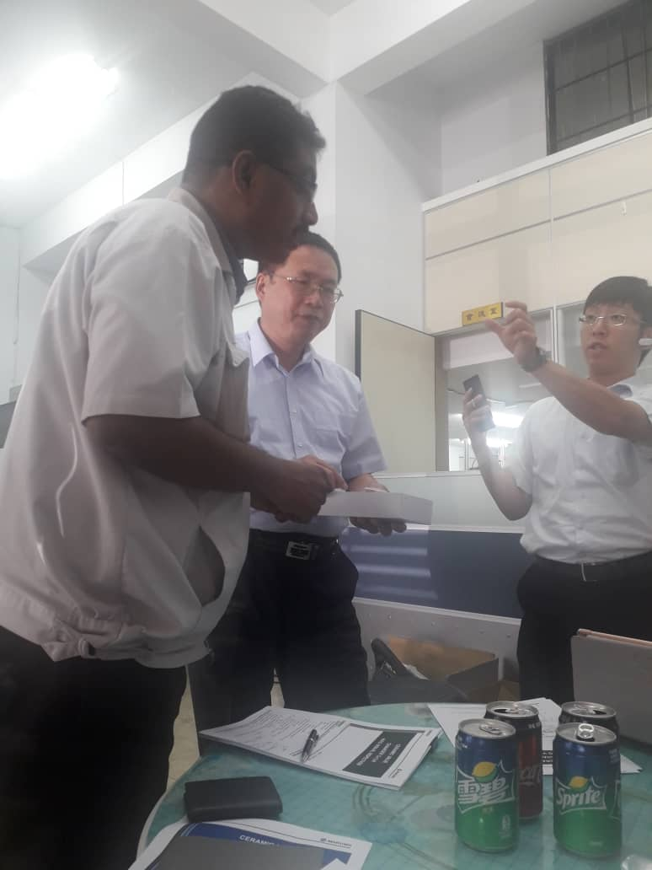
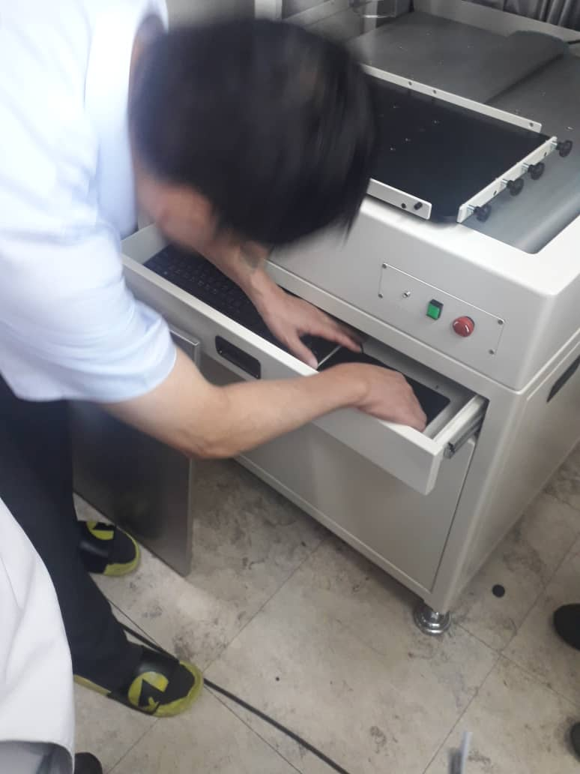
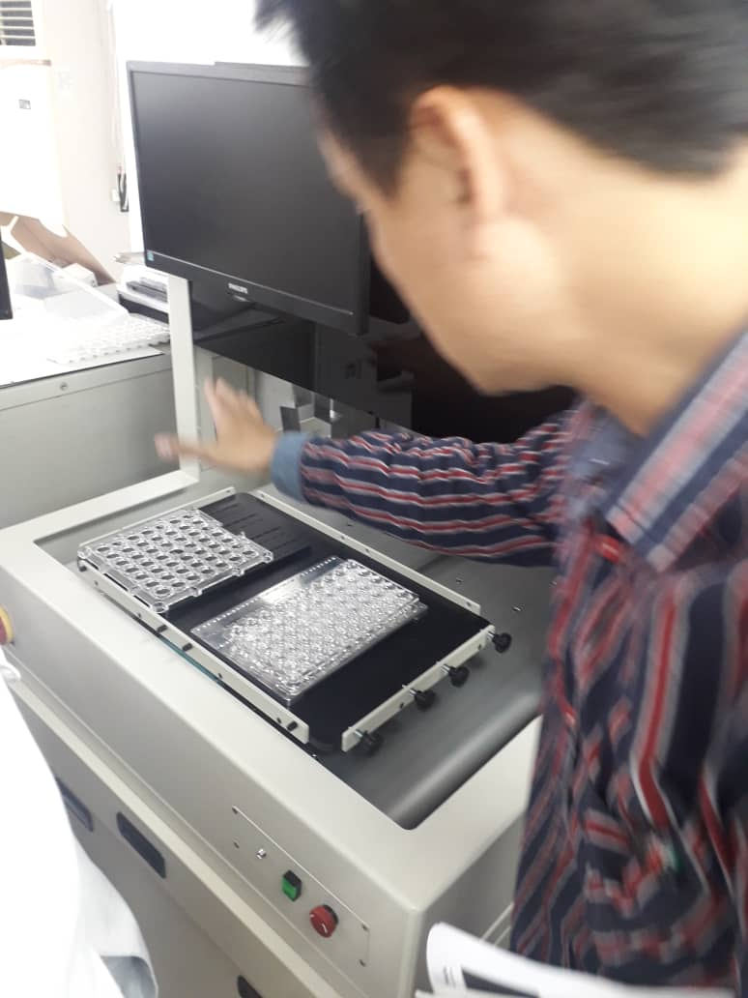
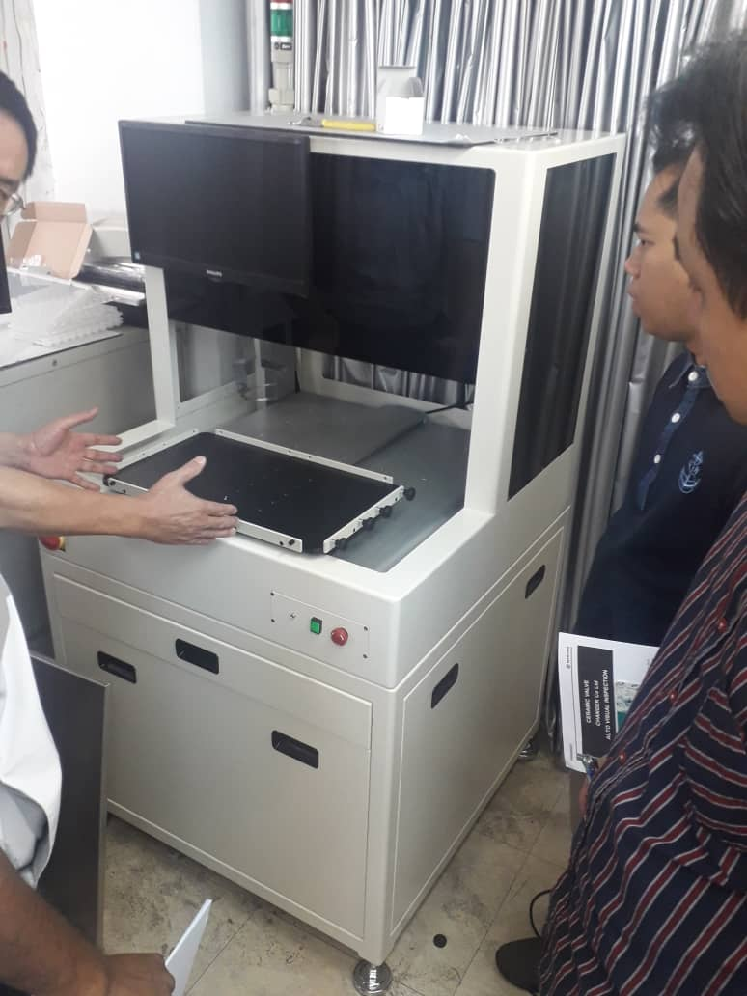
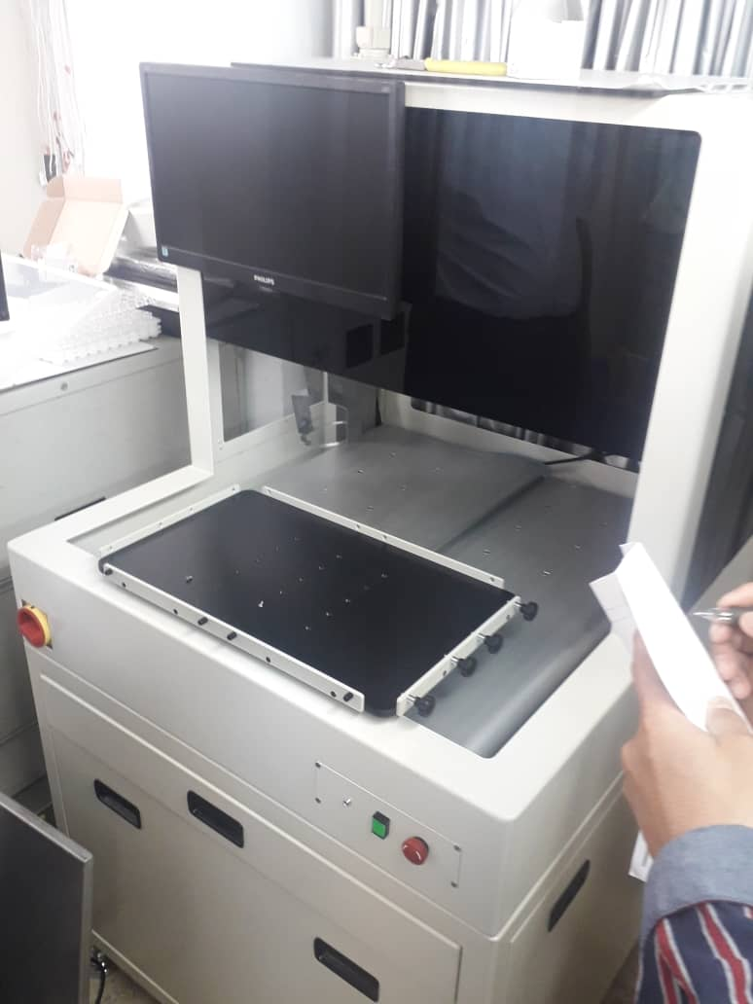
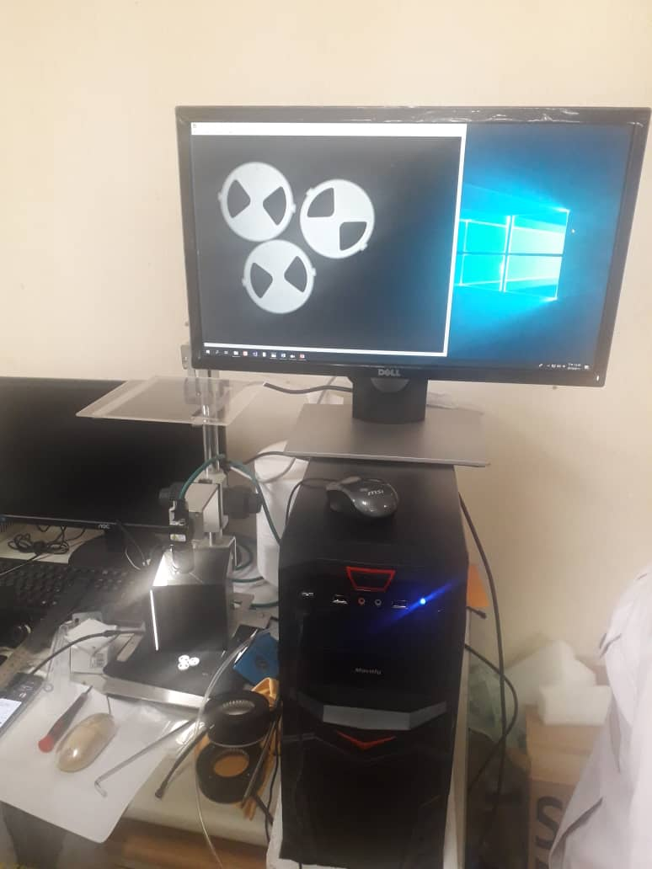
CERAMIC VALVE – AUTO VISUAL INSPECTION
Images of the supplier visit
CV VISUAL MACHINE

Slide 6
FERRITE MAGNET
CHERNGER Co Ltd
FM AUTO VISUAL INSPECTION
ECN
DATE : 11th SEPT 2018

Slide 7
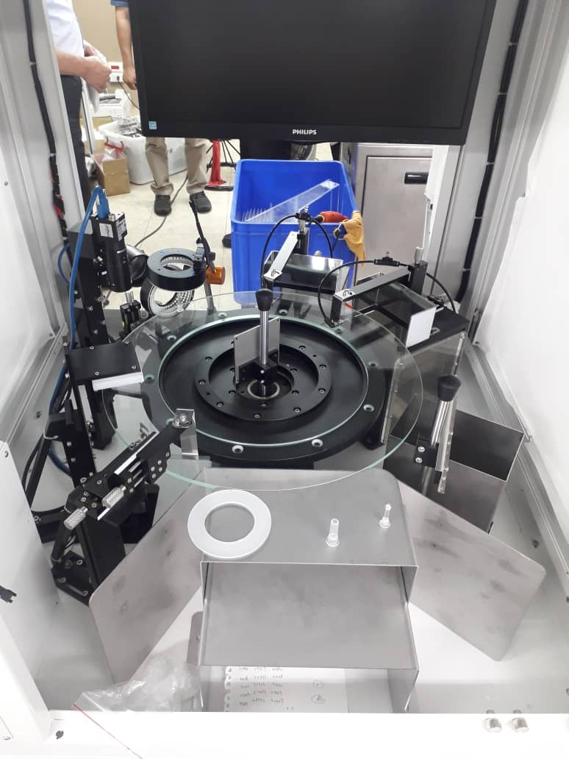
FERRRITE MAGNET– AUTO VISUAL INSPECTION
Visit details
Members : Mr Azham (CV HOD)
Mr Eruan (FMD)
Mr Siva (QA)
Supplier : Chernger Tech Co Ltd Mr Liu
Ferrite Magnet Visual machine was shown to the team for review. This machine was design for pun check but applicable for ferrite magnet product
Machine capability
Dimension 100%
Visual all surface 100%
Concept : Glass Turn table & feeder bowl
Current Action :
Supplied sample product for evaluation and
will feedback to Maruwa on the status by 22nd Sept
Sample inspection machine

Slide 8
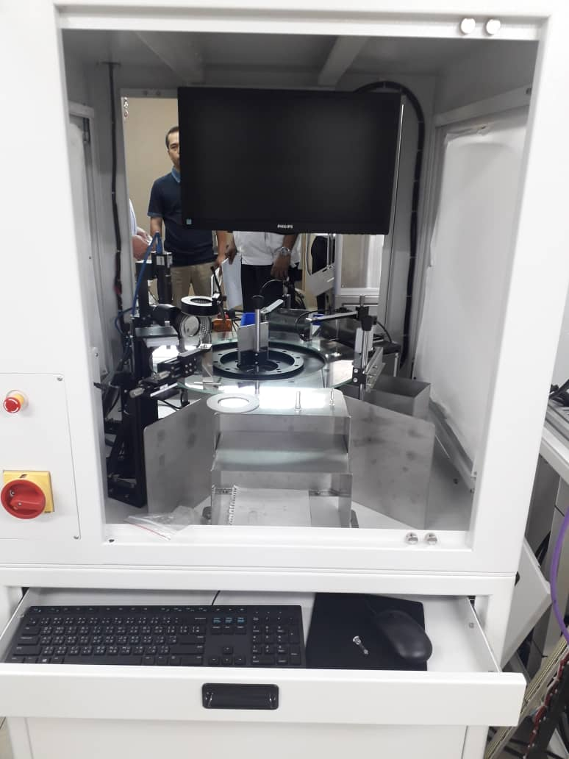
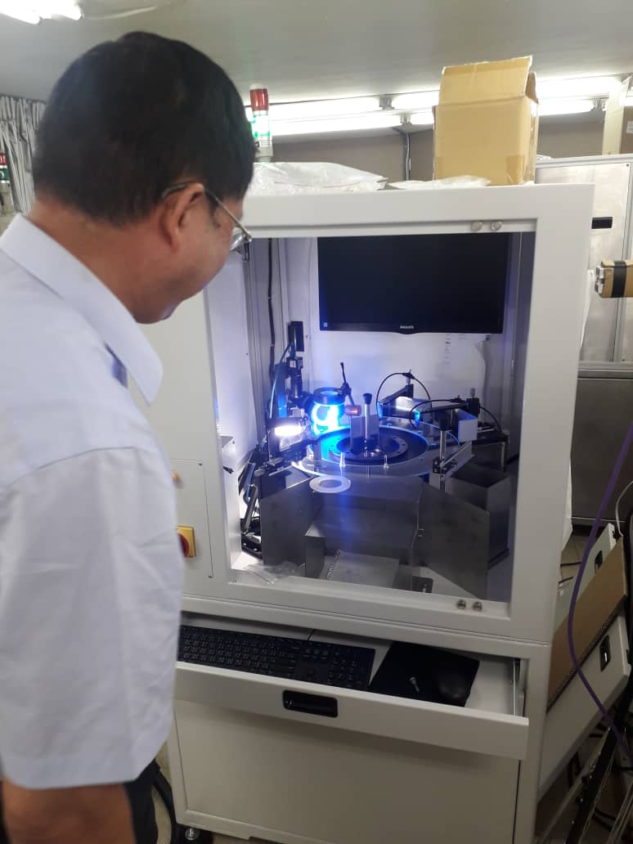
FERRITE MAGNET– AUTO VISUAL INSPECTION
Images of the supplier visit
FM VISUAL MACHINE FOR BB TYPE PRODUCT

Slide 9
TPH
WINSTAR Technology
AUTO VISUAL INSPECTION
ECN
DATE : 11th SEPT 2018

Slide 10
TPH – AUTO VISUAL INSPECTION
Visit details
Members : Mr Justin (TPH HOD)
Mr Eruan (FMD)
Mr Siva (QA)
Supplier : Winstar Tech Co Ltd Mr Zinn Ler
Date : 11th Sept
Agenda discussion
UPH
L Sub UPH : 3.5sec/pc 12hrs : 12.3kpcs
2. Machine operation – Detail
Safety – Standard safety features included
Maintenance – 1years guranttee with 24hrs operation for all parts. Supplier will standby parts for any emergency use
Manual (Software & hardware) – will provide as per maruwa’s requirement
3. Sample result verification (Previous & new sample)
Initial sample – pass and able to detect
2nd sample – concentrate more on defect measurement and MM need to provide the defect matrix for supplier programming

Slide 11
TPH – AUTO VISUAL INSPECTION
4. Result storage
Image storage
Running qty - linkage to PC system (server)
Machine program coding
Data storage mode – SQL format
Supplier able to comply with Maruwa’s requirement
5. After sales service
Warranty – 1 year on all parts
Support via remote - able to do it and technical support will be carry by local from JB office
6. Pricing & Payment term
Quotation will revise with additional of loading station for input. Quotation submit by 14th Sept
8. Lead time for delivery – 3 ~ 4 months. MM team requested for 6 ~ 8 weeks

Slide 12
TPH – AUTO VISUAL INSPECTION
Activity by Maruwa Malaysia
a. Matrix by defect PIC: Mr Justin 21st Sept
Conclusion
The working committee propose to proceed with this project.
Current concentration will be for
No of machine – propose 2 units

Slide 13
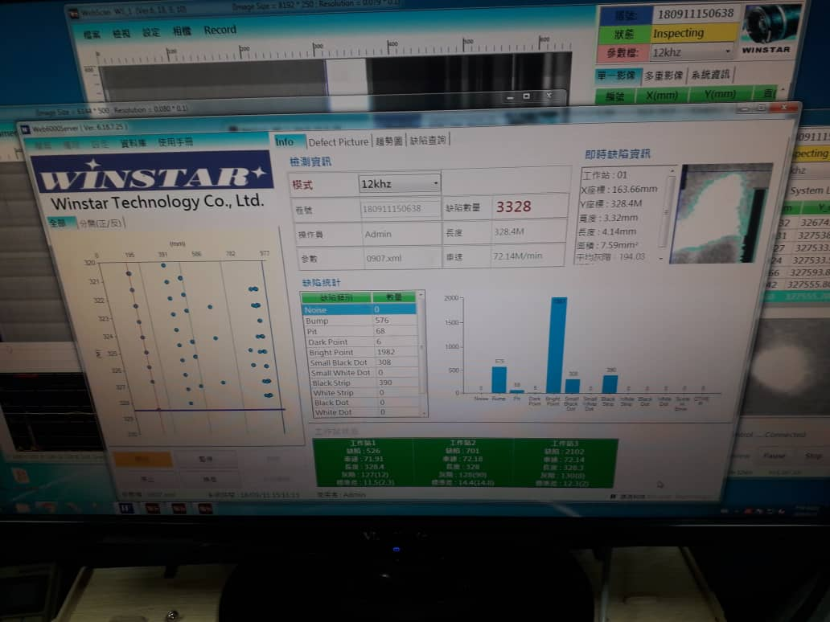
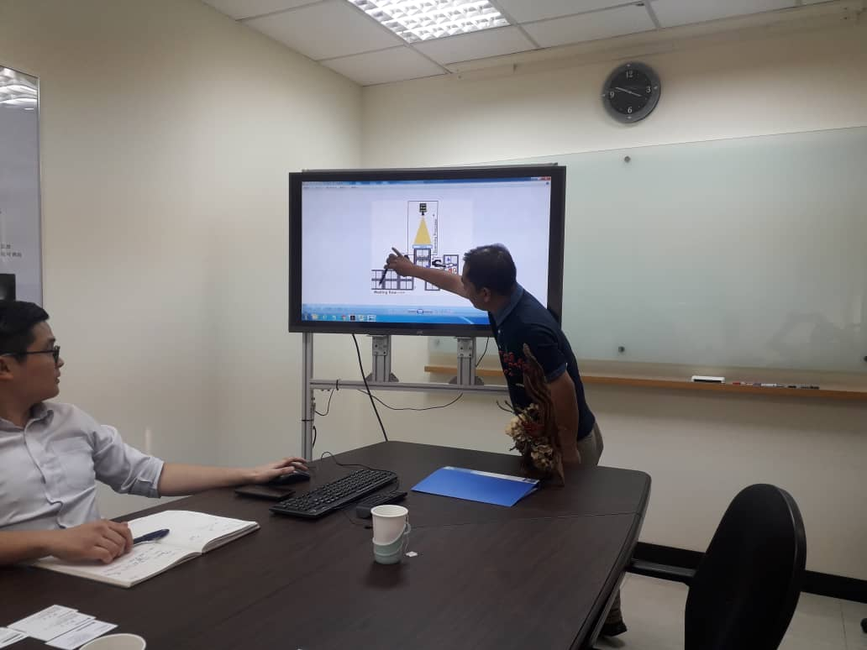
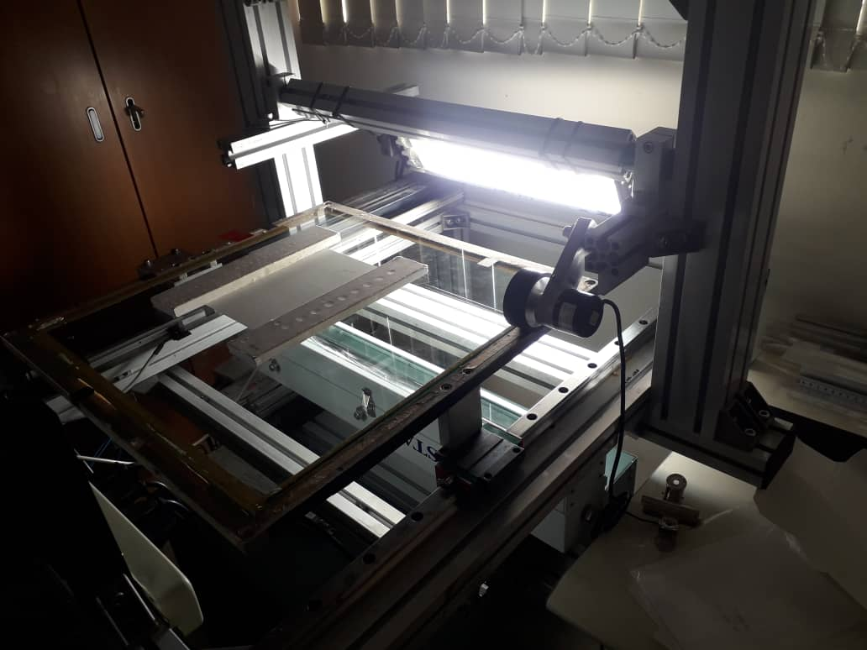
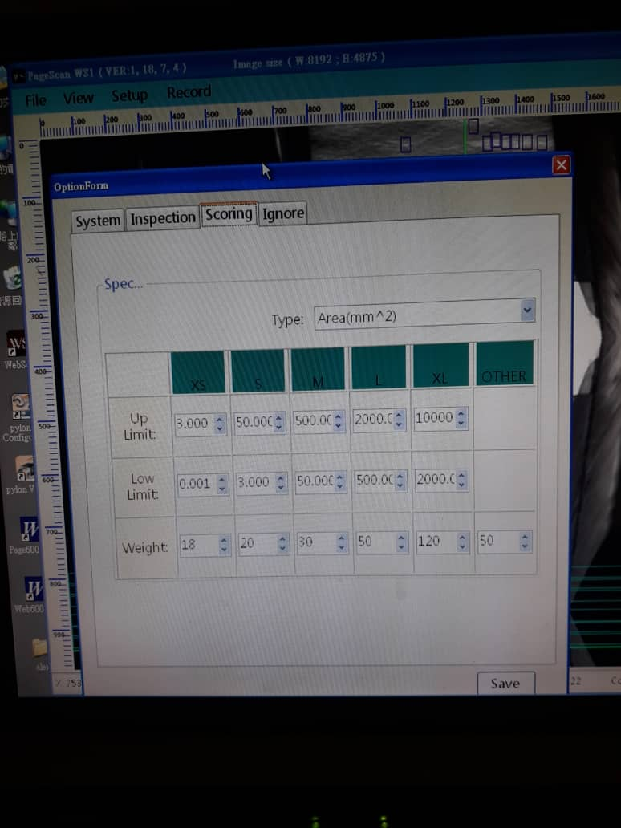
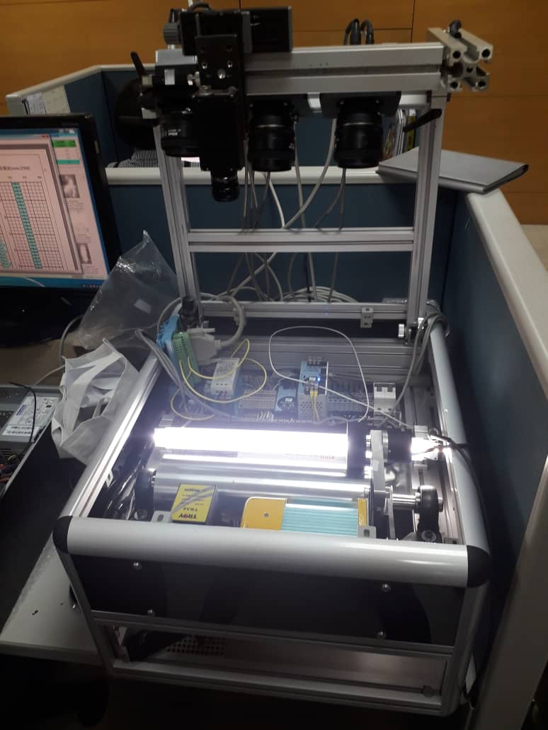
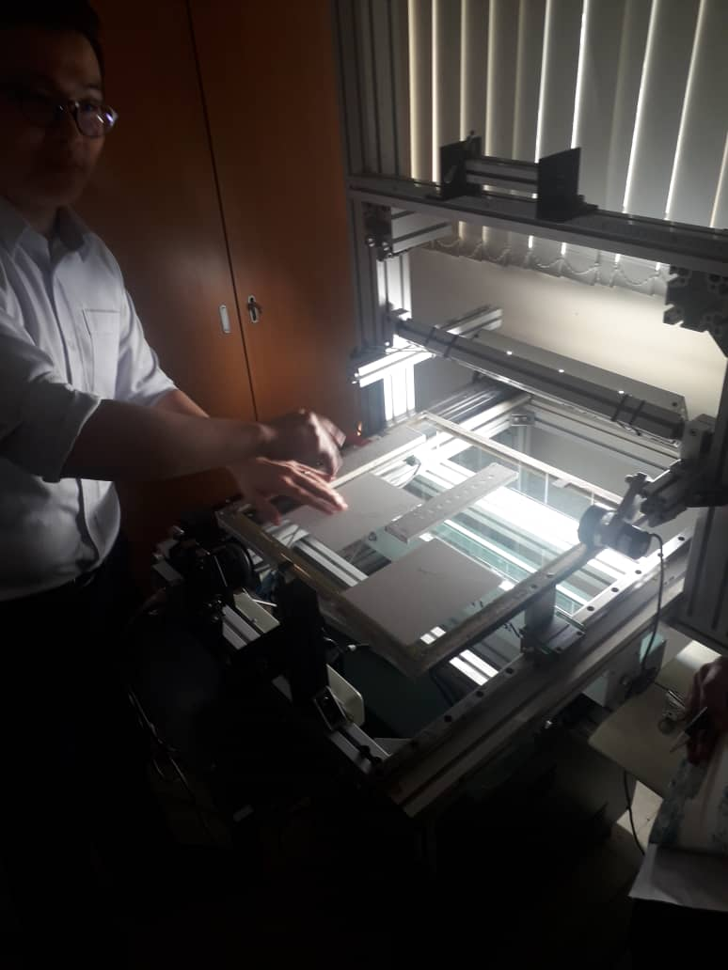
CERAMIC VALVE – AUTO VISUAL INSPECTION
Images of the supplier visit
TPH VISUAL INSPECTION MACHINE

Slide 14
SUBSTRATE
WINSTAR Technology
FILM INSPECTION
ECN
DATE : 11th SEPT 2018

Slide 15
SUBSTRATE – FILM INSPECTION (WINSTAR)
Agenda discussion
11th Sept Discussion
Inspection requirement
Speed
Defect detection – solid, dent, line & stick
Machine auto stop – defect detected auto stop
Visual field of view
Machine operation – Details of safety
2. Capacity : 15 ~ 30mtr/min
30min/film (800mtr) → Able to 100% inspection for 1 machine with 12hrs operation
System Function
Upon detected NG ➔ film inspection unit will stop for clean up or dispose
Next action
Need to submit Ng sample for confirmation
Propose
This machine can be utulise for TPH Casting machine
System will do marking which can be remove by opt during GREEN SHEET INSPECTION

Slide 16
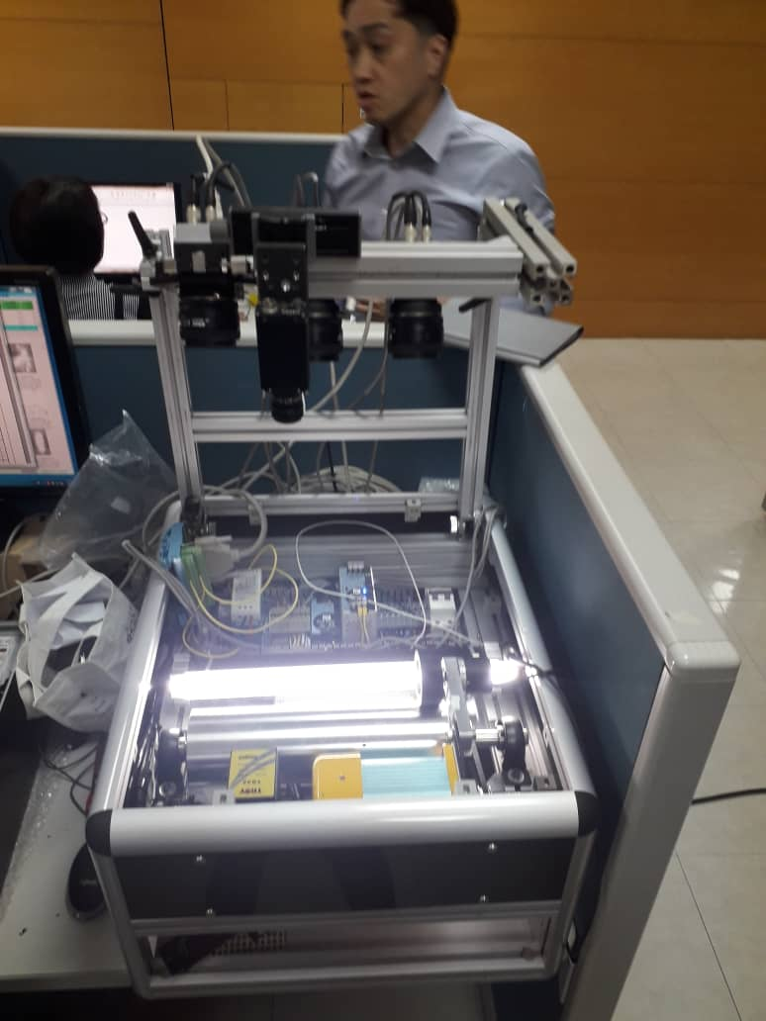
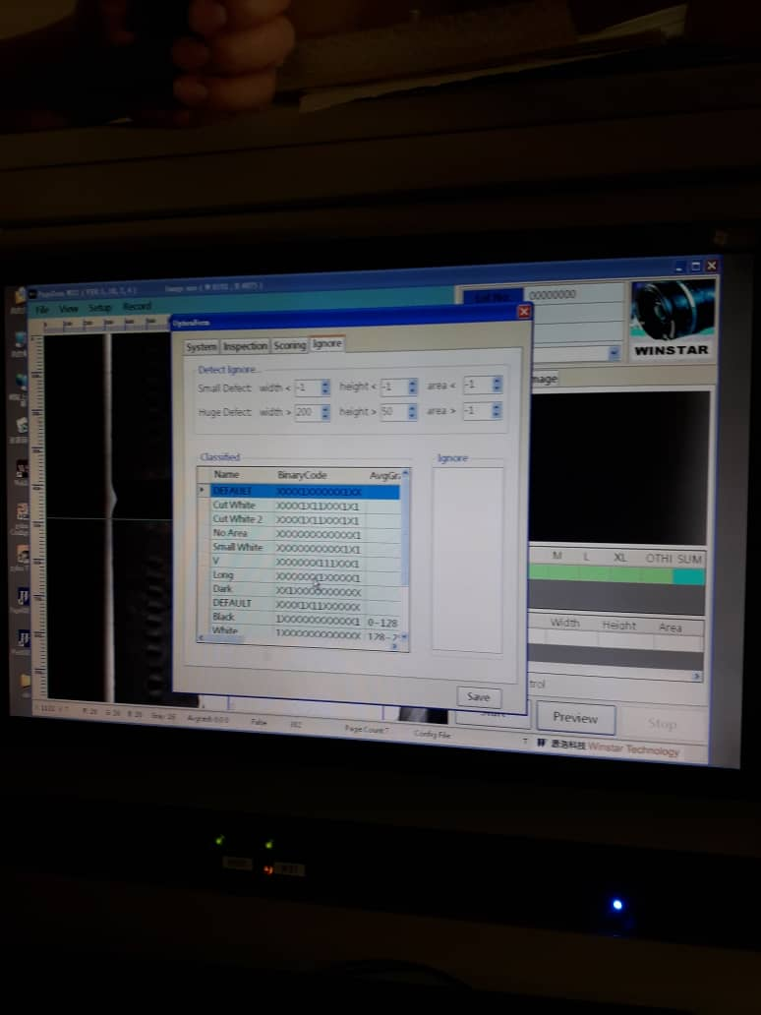
SUBSTRATE – FILM INSPECTION (WINSTAR)
Images of the supplier visit
FILM INSPCTION DEMO UNIT

